Slide 1

Development of machine learning models to process Electronic Health Records – Imputation Strategies
Week 24 Meeting, 4/4/2021

Slide 2
Machine Learning with Health records

Slide 3
Healthcare Information Retrieval from Data
Prescriptive Analytics
Predictive Analytics
Diagnostic Analytics
Descriptive Analytics
Notes:
--Panesar Machine Learning and AI for Healthcare, 2018
Descriptive Analytics: Descriptive analytics brings insight to the past, focussing on the question
of what happened, through analyzing data from history. Descriptive
analytics uses techniques such as data aggregation and data mining
to provide historic understanding. There is much to be learned from
descriptive analytics. Common examples of descriptive analytics are
reports that provide the answers to questions such as how many patients
were admitted to a hospital last July, how many were readmitted within 30
days, and how many caught an infection or suffered from a mistake in care.
Descriptive analytics serves as the first form of big data analysis.
Data can become more valuable through dataset linking. For instance,
linking physician appointments to hospital admissions, to education
attendance, medication adherence, and access to services can provide
substantial insight and understanding for health delivery optimization and
cost savings.
Limitations of descriptive analytics are that it gives limited ability to
guide decisions because it is based on a snapshot of the past. Although this
is useful, it is not always indicative of the future.
Diagnostic Analytics: Diagnostic analytics is a form of analytics that examines data to answer
the question of why something happened. Diagnostic analytics comprises
of techniques such as decision trees, data discovery, data mining, and
correlations.
Predictive analytics allows us to understand the future and predict the
likelihood of a future outcome. Predictive analytics uses the data that you have
at your disposal and attempts to fill in missing data with best-guess estimates.
Predictive analytics skills are in demand as healthcare providers seek
evidence-based ways to reduce costs, take advantage of value-based
reimbursements, and avoid the penalties associated with the failure to
control chronic diseases and adverse events that are within their power
to prevent.
Prescriptive analytics strives to make decisions for optimal outcomes: that
is, to use all available data and analytics to inform and evolve a decision of
what action to take—that is, smarter decisions. Prescriptive analytics attempt
to quantify the effect of future decisions to advise on possible outcomes
before decisions are made. At its best, prescriptive analytics predicts not only
what will happen but also why it will happen to provide recommendations
regarding actions that will take advantage of the predictions.

Slide 4

Mortality
Most commonly used outcome in prediction studies
Deceptively simple outcome to define
Susceptible to selection biases
Interpretation varies according to the time window
Notes:
Bulgarelli et al. Prediction on critically ill patients: The role of “big data”, Journal of Critical Care, 2020.
-Mortality is the most commonly used outcome in prediction studies in critical care, and indeed potentially
across all of medicine.
-Mortality is a strong surrogate for illness, and machine learning practitioners use this signal to infer the relationship between clinical data and patient acuity. - -Mortality is a deceptively simple outcome: while it should be simple to define, the nature of retrospective data often complicates matters.
In MIMIC database, a number of patients have two consecutive hospitalizations in which they die as organ donors are treated as distinct hospital
admissions .
-Mortality is also susceptible to selection biases based upon the source of the information. Many studies report hospital mortality as it is feasible to collect this information. As a result, discharges to hospice which ultimately end in death are not accounted for, adding noise to the outcome and, if a systematic workflow exists for discharging severely ill patients to hospice, biasing any trained models.
-Other important factors in defining mortality as an outcome are controllable by the researcher.
-- For example, defining mortality as death within 30 days of admission will provide a stronger signal for immediate physiologic abnormality likely related to the patient's admission,
--while 1-year mortality will emphasize chronic illness and comorbid conditions.

Slide 5
Descriptive analytics
Why use logistic regression

Slide 6
Add functional requirements

Slide 7
Remaining parts
Complete MIDAS imputation theory
Coverage rate, average width
Discuss results in detail
Finish Conclusion and abstract properly

Slide 8
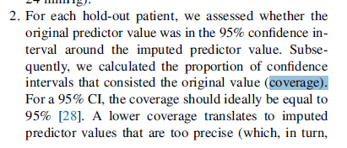
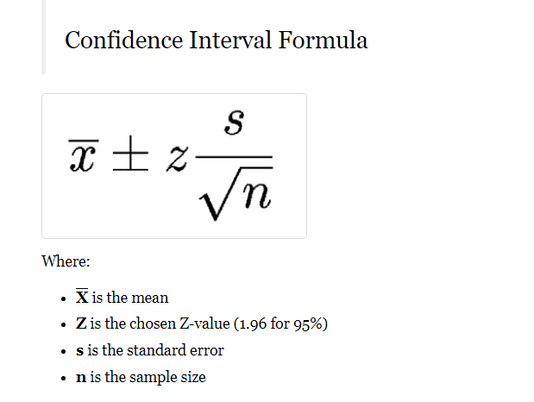
Questions
Coverage rate, average width
Does it mean my cross validation?

Slide 9
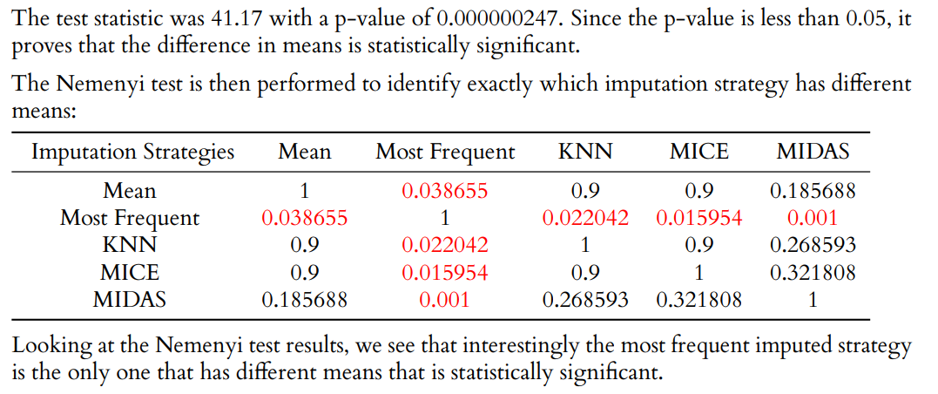
Questions
Not sure if I am doing the Nemnyi test properly
Friedman Test:
The null hypothesis is that the mean of the 10 folds for each imputation strategy is equal.
The alternative hypothesis is that at least one mean of the 10 folds is different for the imputation strategies.

Slide 10
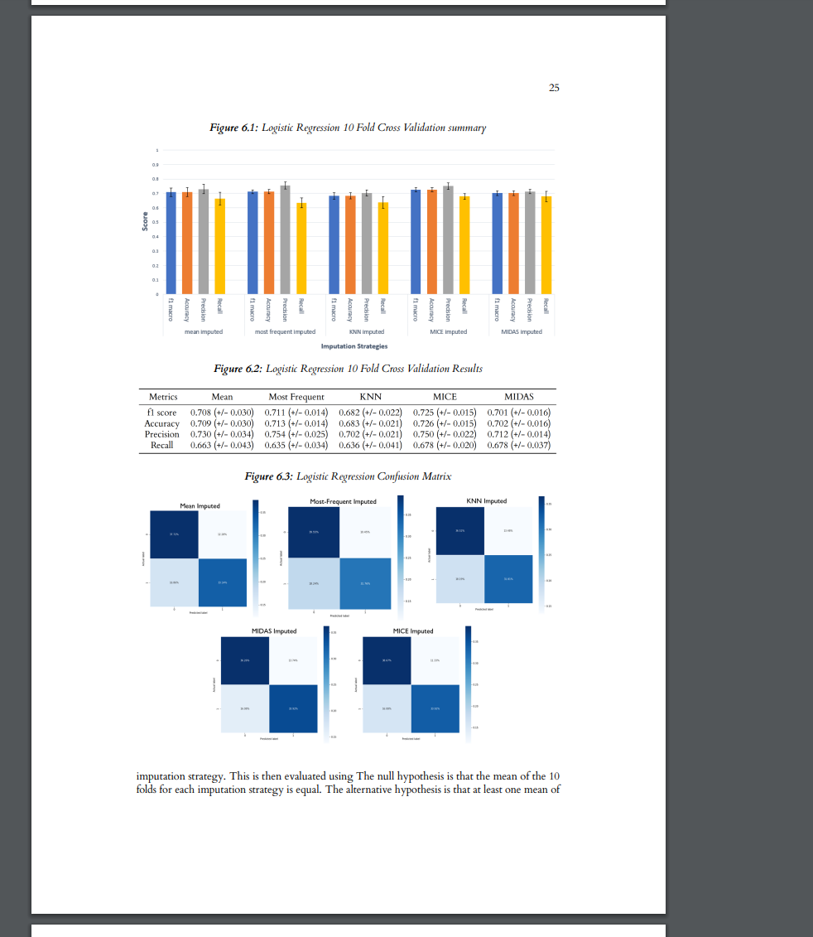
Questions
Should I discuss the results for both logistic regression and random forest or just do 1 and put the rest in appendix
Just metrics for one model is filling up the entire page
I proposed 3 different machine learning models, but they all perform similarly with similar trends

Slide 11
Questions
Title: DEVELOPMENT OF MACHINE LEARNING MODELS TO PROCESS ELECTRONIC HEALTH RECORDS – IMPUTATION STRATEGIES

